Slide 1
Introduction to Data Structures

Slide 2
Data Structures
Data structure is a representation of data and the operations allowed on that data.
A data structure is a way to organize and store data in order to facilitate the access and modifications.
In easy words it is a way in which data is stored on a computer.
Data structure is the implementation that we provide or specify like set of rules etc. that defines how the data will be accessed, modified, or stored etc.

Slide 3
Data Structures
Any data structure is designed to organize data to suit a specific purpose so that it can be accessed and worked with in appropriate ways
In computer programming, a data structure may be selected or designed to store data for the purpose of working on it with various algorithms

Slide 4
Real World Example
Dictionary is an example of how data structure work in real life.
There are more than a thousand words in a dictionary. Suppose you want to search the definition of the word “Work”. You know that first you will look in the “W” section then in the “Wo” so on to find the word “Work”. This process sounds easy because the dictionary is arranged in this particular order. It would be impossible to search for a word in a dictionary without any order. This is exactly how data structures work.
Data structure organizes, and sorts your data as per pre-defined rule or order.

Slide 5
Data Structure Classification
Generally classified into:
Primitive Data Structures, and
Non – Primitive Data Structures

Slide 6
Primitive Data Structures
Fundamental data types which are supported by a programming language
Basic data types such as integer, real, character and Boolean are known as Primitive Data Structures
These data types consists of characters/single values that cannot be divided and hence they also called simple data types

Slide 7
Non-Primitive Data Structures
Non-primitive data structures are those data structures which are created using primitive data structures and are not predefined.
Examples of non-primitive data structures is the processing of complex numbers
Based on the structure and arrangement of data, further classified into
Linear Data Structure, and
Non – Linear Data Structure

Slide 8
Types of Data Structures
There are two types of data structures:
Linear (data is stored in a sequence)
Non Linear (data is not stored in a sequence)
Linear Data Structures
Stack
Queue
Linked List
Non-Linear Data Structures
Tree
Graphs

Slide 9
Linear Data Structure
A data structure is said to be linear if its elements form a sequence or a linear list.
There are basically two ways of representing such linear structure in memory.
One way is to have the linear relationships between the elements represented by means of sequential memory location.
The other way is to have the linear relationship between the elements represented by means of pointers or links. These linear structures are called linked lists.

Slide 10
Linear Data Structure
The common examples of linear data structure are Arrays, Linked Lists , Queues, Stacks

Slide 11
Non Linear Data Structure
A data structure is said to be non-linear if the data are not arranged in sequence or a linear
This structure is mainly used to represent data containing a hierarchical relationship between elements.
Trees and Graphs are the examples of non-linear data structures

Slide 12
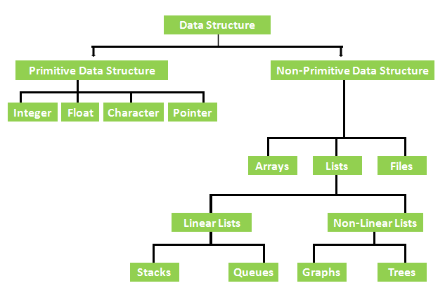
Data Structure Classification

Slide 13
Graphical Representation
Array
Linked list
Queue
Tree
Stack

Slide 14
Selection of Data Structure
The choice of particular data structure depends on two consideration
The structure should be simple enough that one can effectively process the data when necessary
It must be rich enough in structure to represent the relationship between data elements

Slide 15
Types of Data Structure
Linear: In Linear data structure, values are arrange in linear fashion
Array: Fixed-size
Linked-list: Variable-size
Stack: Add element in front and remove from front
Queue: Add element at end/rear and remove from front

Slide 16
Types of Data Structure
Non-Linear: The data values in this structure are not arranged in order
Tree: Data is organized in branches
Graph: A more general branching structure, with less strict connection conditions than for a tree

Slide 17
Array
Array is a structure/container which can hold a fix number of items and these items should be of the same data-type
Most of the data structures make use of arrays to implement their algorithms
Following are the important terms to understand the concept of Array
Element - Each item stored in an array is called an element.
Index - Each location of an element in an array has a numerical index, which is used to identify the element.

Slide 18
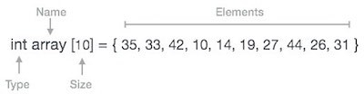
Representation of Array
Arrays can be declared in various ways in different languages.
For illustration, let's take C array declaration

Slide 19

Stack
It is a linear data structure.
It follows a particular order in which the operations are performed.
The order may be LIFO(Last In First Out).
Behaves like a real world stack. Example: Stack of books.
Consider an example of books stacked over one another. The book which is at the top is the first one to be removed, i.e. the book which has been placed at the bottommost position remains in the stack for the longest period of time. So, it can be simply seen to follow LIFO(Last In First Out) order.

Slide 20
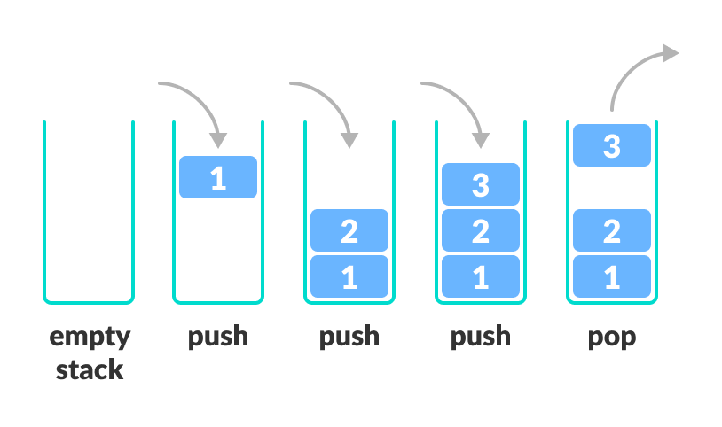
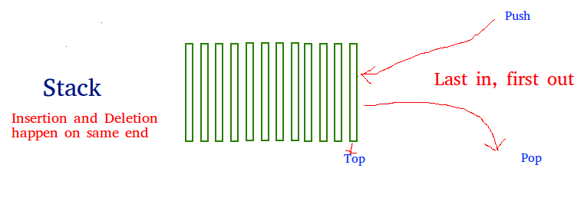
Working of a Stack
In programming terms, putting an item on top of the stack is called push and removing an item is called pop.
Push: Add an element to the top of a stack
Pop: Remove an element from the top of a stack

Slide 21
Example
Suppose the following stack
Push 6 in stack
Push 10 in stack
Stack is full. Pop a number and add 11 in stack
10
6
3
4
5
3
4
5
6
3
4
5
10
6
3
4
5
6
3
4
5
11
6
3
4
5

Slide 22

Queue
It is a linear data structure.
It follows a particular order in which the operations are performed i.e. FIFO (First In First Out).
Behaves like a real world Queue.
It is similar to the ticket queue outside a cinema hall, where the first person entering the queue is the first person who gets the ticket.

Slide 23
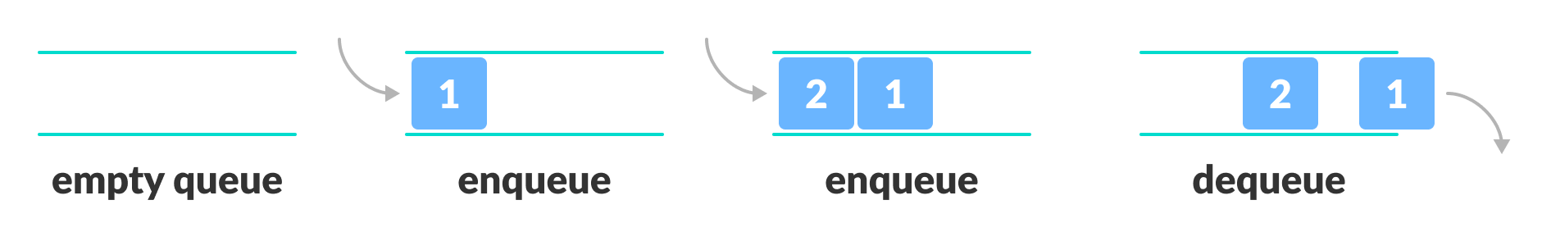
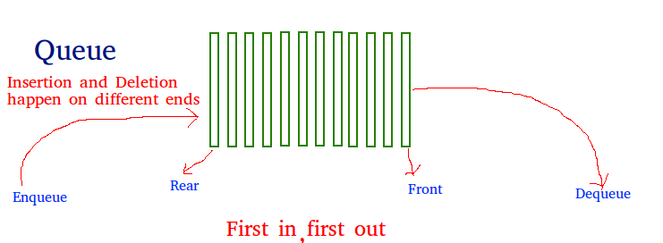
Working of a Queue
Queue follows the First In First Out (FIFO) rule - the item that goes in first is the item that comes out first. In programming terms, putting items in the queue is called enqueue, and removing items from the queue is called dequeue.

Slide 24
Example
Suppose the following queue
Add 6 in queue (enqueue)
Add 10 in queue (enqueue)
Queue is full. Remove a number (dequeue) and add 11 in queue.
10 | 6 | 3 | 2 | 1
3 | 2 | 1
10 | 6 | 3 | 2 | 1
6 | 3 | 2 | 1
 | 10 | 6 | 3 | 2
11 | 10 | 6 | 3 | 2

Slide 25
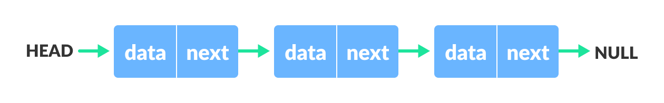
Linked List
It is a linear data structure.
Includes a series of connected nodes. Here, each node stores the data and the address of the next node as a null-pointer. For example:
Real life example: undo button

Slide 26
Linked List
A Flexible structure, because can grow and shrink on demand
Elements can be, Accessed, Inserted, and Deleted, at any position
Only drawback is that direct access to a specific memory location, as done with array indices, is not possible without traversing the list sequentially

Slide 27
Tree
A Tree is a collection of elements called nodes
One of the node is distinguished as a root, along with a relation (“parenthood”) that places a hierarchical structure on the nodes

Slide 28
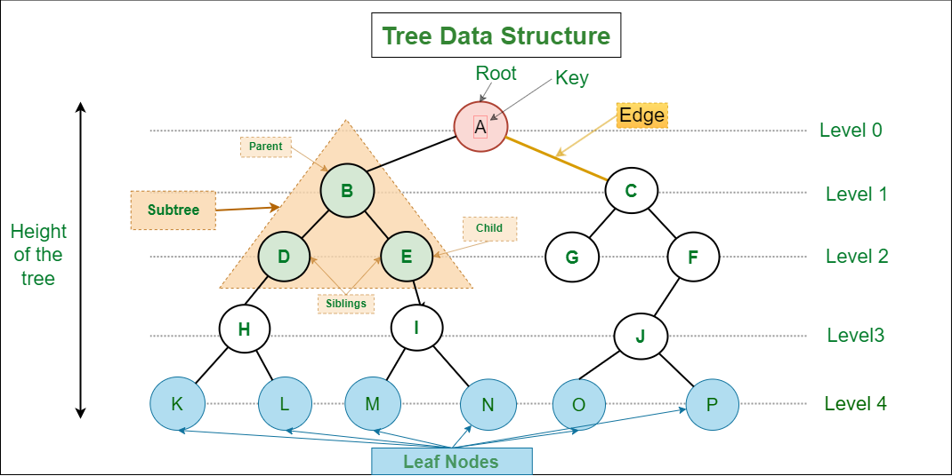
Tree
Node with no child further → Leaf Node

Slide 29
Graph
A Non-Linear data structure consisting of two things
Nodes / Vertices – set of elements
Edges / Links – identified by a pair of nodes

Slide 30
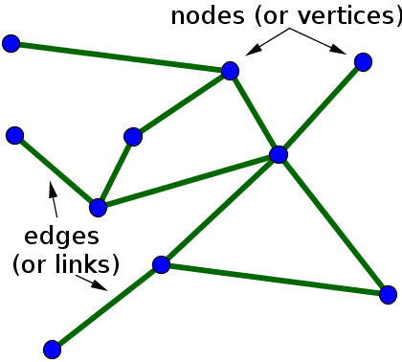
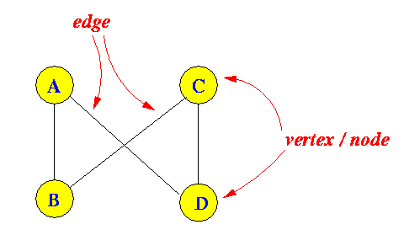
Graph – Nodes and Edges

Slide 31
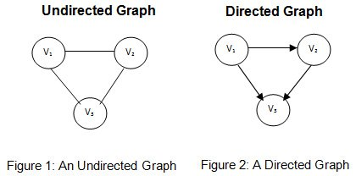
Types of Graph
In an undirected graph, edges have no direction. They simply represent a connection between two vertices without indicating any flow or one-way relationship.
In a directed graph, edges have a direction. Each edge is represented by an ordered pair of vertices, indicating a one-way relationship from one vertex to another.

Slide 32
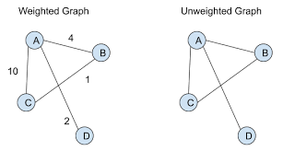
Types of Graph
In a weighted graph, each edge is assigned a numerical value or weight that represents a certain measure such as distance, cost, time, or any other relevant quantity.
Weighted graphs are commonly used in applications where the strength or cost of the connections plays a crucial role, such as in network optimization or routing problems.
In an unweighted graph, all edges are considered to have the same value or weight, typically representing a simple connection between vertices.
Unweighted graphs are often used to model relationships where the strength or cost of the connection between vertices is not relevant.

Slide 33
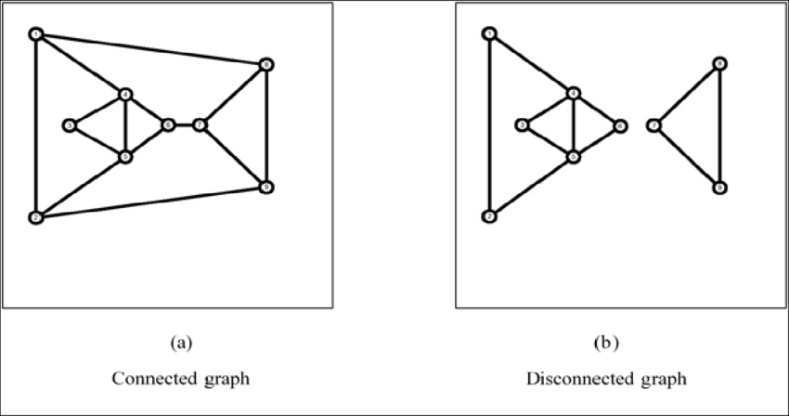
Types of Graph
A connected graph is a graph in which there exists a path between every pair of vertices. In other words, every vertex in the graph is reachable from every other vertex through a sequence of edges.
It is used to model scenarios where all entities or nodes are reachable or communicable with each other.
A disconnected graph is a graph in which there are at least two vertices with no path connecting them. The graph consists of two or more separate connected components.
It represent scenarios where certain entities or nodes are not reachable from others.

Slide 34
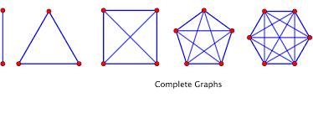
Types of Graph
A complete graph is a type of simple graph in which there is a unique edge connecting every pair of distinct vertices. In other words, in a complete graph, there is an edge between every pair of vertices. If a complete ( undirected ) graph has n vertices, it will have
( n * (n−1) ) / 2 edges.

Slide 35
Graph and Tree
A connected acyclic graph is called a tree
In other words, a connected graph with a root node and no cycles(loops)
is called a tree

Slide 36
Key Operations on Data Structures

Slide 37
Key Operations
The data appearing in data structures are processed by means of certain operations
The following four operations play a major role in this context

Slide 38
Traversing
Accessing each record/node exactly once so that certain items in the record may be processed
This accessing and processing is sometimes called “visiting” the record

Slide 39
Searching
Finding the location of the desired node with a given key value, or
Finding the locations of all such nodes which satisfy one or more conditions

Slide 40
Inserting / Deleting
Adding a new node/record to the structure
Removing a node/record from the structure

